Slide 1

Banker’s Algorithm for Deadlock Avoidance

Slide 2

References
1. Abraham Silberschatz, Peter Baer Galvin and Greg Gagne, Operating System Concepts, WILEY,ISBN 978-1-118-06333-0, 9th Edition
21/02/19
Operating system
‹#›
Notes:
‹#›
MIT-WPU

Slide 3
Banker’s Algorithm
Aim:
To implement Bankers Algorithm for deadlock avoidance using
(a) Safety algorithm
(b) resource request algorithm
Objectives:
To understand the concept of deadlock.
How to avoid deadlock by implementing safety algorithm.
*
COMPUTER ENGINEERING AND TECHNOLOGY
‹#›

Slide 4
Data Structures for the Banker’s Algorithm
Let n = number of processes, and m = number of resources types.
Available: Vector of length m. If available [j] = k, there are k instances of resource type R_{j} available.
Max: n x m matrix. If Max [i,j] = k, then process P_{i} may request at most k instances of resource type R_{j}.
Allocation: n x m matrix. If Allocation[i,j] = k then P_{i} is currently allocated k instances of R_{j.}
Need: n x m matrix. If Need[i,j] = k, then P_{i} may need k more instances of R_{j} to complete its task.
Need [i,j] = Max[i,j] – Allocation [i,j].

Slide 5
Safety Algorithm
To determine whether system is in safe state
1. Let Work and Finish be vectors of length m and n, respectively. Initialize:
Work := Available
Finish [i] = false for i = 1,2, …, n.
2. Find an i such that both:
(a) Finish [i] = false
(b) Need_{i} ≤ Work
If no such i exists, go to step 4.
3. Work := Work + Allocation_{i} Finish[i] := true go to step 2.
4. If Finish [i] = true for all i, then the system is in a safe state.

Slide 6
Resource-Request Algorithm
Request_{i} = request vector for process P_{i}.
If Request_{i} [j] = k then process P_{i} wants k instances of resource type R_{j.}
If Request_{i} ≤ Need_{i} go to step 2. Otherwise, raise error condition, since process has exceeded its maximum claim.
If Request_{i} ≤ Available, go to step 3. Otherwise P_{i} must wait, since resources are not available.
3. Pretend to allocate requested resources to P_{i} by modifying the state as follows:
Available := Available - Request_{i};
Allocation_{i} := Allocation_{i} + Request_{i};
Need_{i} := Need_{i} – Request_{i;;}
Call safety algorithm
If safe ⇒ the resources are allocated to P_{i}.
If unsafe ⇒ P_{i} must wait, and the old resource-allocation state is restored

Slide 7
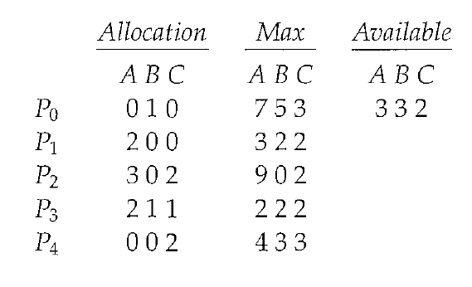
Example of Banker’s Algorithm
5 processes P₀ through P₄; 3 resource types A (10 instances), B (5 instances), and C (7 instances).
Snapshot at time T₀:

Slide 8
Example (Cont.)
The content of the matrix. Need is defined to be Max – Allocation.
Need
A B C
P₀ 7 4 3
P₁ 1 2 2
P₂ 6 0 0
P₃ 0 1 1
P₄ 4 3 1
The system is in a safe state since the sequence < P₁, P₃, P₄, P₀, P₂> or < P₁, P₃, P₄, P₂, P₀> satisfies safety criteria.

Slide 9
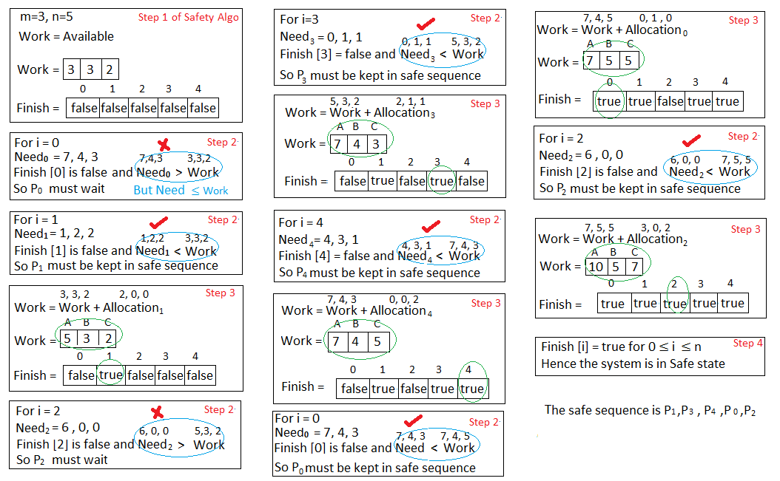
*
‹#›

Slide 10
Example (Cont.)……
At time T₁:
P₁ request (1,0,2)

Slide 11
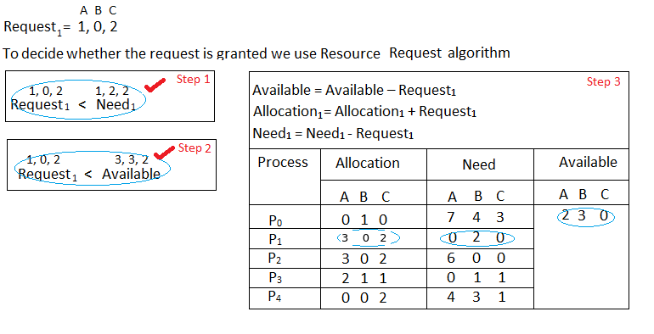
Resource-Request algorithm
*
‹#›

Slide 12
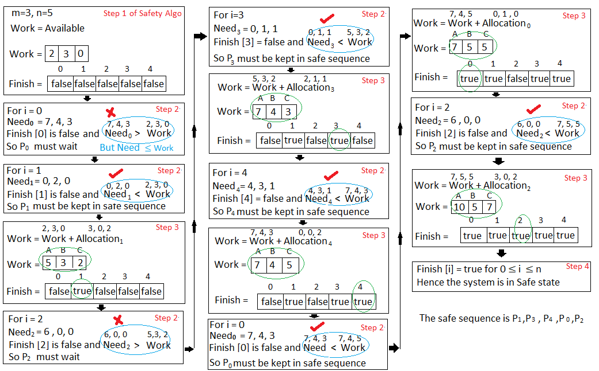
*
‹#›

Slide 13
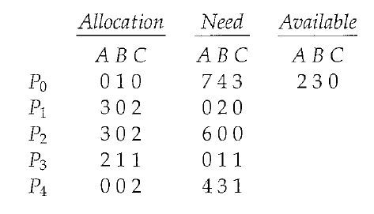
Example (Cont.): P₁ request (1,0,2)
Check that Request ≤ Available (that is, (1,0,2) ≤ (3,3,2) ⇒ true.
Executing safety algorithm shows that sequence <P₁, P₃, P₄, P₀, P₂> satisfies safety requirement.

Slide 14
Example (Cont.)
At time T₂: Can request for (3,3,0) by P₄ be granted?
At time T₃: Can request for (0,2,0) by P₀ be granted?

Slide 15
Steps for implementation
1. Accept no of processes
2. Accept no of resource types
3. Accept available, max, allocation matrices
4. Determine need matrix
5. Invoke safety algorithm and display the safety sequence
6. If system is in safe state, accept resource request from user
7. Invoke resource-request algorithm
8. Display whether request can be granted and display safe sequence if any
*
COMPUTER ENGINEERING AND TECHNOLOGY
‹#›

Slide 16
Steps for implementation
1. Accept no of processes
2. Accept no of resource types
3. Accept available, max, allocation matrices
4. Determine need matrix
5. Invoke safety algorithm
6. If safe, accept resource request from user
7. Invoke resource-request algorithm
8. Display whether request can be granted and display safe sequence if any
*
COMPUTER ENGINEERING AND TECHNOLOGY
‹#›

Slide 17
output
Following is the SAFE Sequence
P1 -> P3 -> P4 -> P0 -> P2
*
COMPUTER ENGINEERING AND TECHNOLOGY
‹#›

